Slide 1
CSA1606- Data Warehousing and Data Mining OLAP and Data Cubes
Presented By Ajay I (192421147)
Haresh Kumar N L (192425009)
Sakthi Kailash T (192411068)

Slide 2
Introduction to OLAP
OLAP (Online Analytical Processing) is a technology used to analyze large volumes of data from multiple perspectives quickly and efficiently.
It organizes data into multidimensional structures (data cubes), allowing users to view information by dimensions such as time, product, region, or customer.
OLAP supports fast and interactive querying, enabling users to perform complex analyses without affecting transaction processing systems.

Slide 3
Key features of OLAP
Multidimensional Analysis: Analyzes data across multiple dimensions such as Time, Product, Region, and Customer.
Fast Query Performance: Retrieves summarized and detailed information quickly, even from large datasets.
Interactive Data Exploration: Allows users to explore data using operations like Slice, Dice, Roll-Up, and Drill-Down.
Data Aggregation: Automatically summarizes data at different levels (e.g., daily, monthly, yearly).

Slide 4
Examples of OLAP
1. Retail Sales Analysis
A supermarket analyzes sales by product, region, and time.
Example: Compare laptop sales in the North, South, East, and West regions during the last quarter.
2. Banking and Finance
Banks analyze customer transactions, loan performance, and branch-wise revenue.
Example: Compare monthly loan approvals across different branches to identify high-performing locations.

Slide 5
Advantages of OLAP
Fast Data Analysis
Multidimensional Data View
Improved Decision-Making
Interactive Data Exploration
Quick Report Generation
Trend and Pattern Analysis
Data Aggregation and Summarization
Business Intelligence (BI)
High Query Performance
Better Productivity

Slide 6
OLAP Architecture
Operational Databases
ETL Process (Extract, Transform, Load)
Data Warehouse
OLAP Server
Business Users

Slide 7
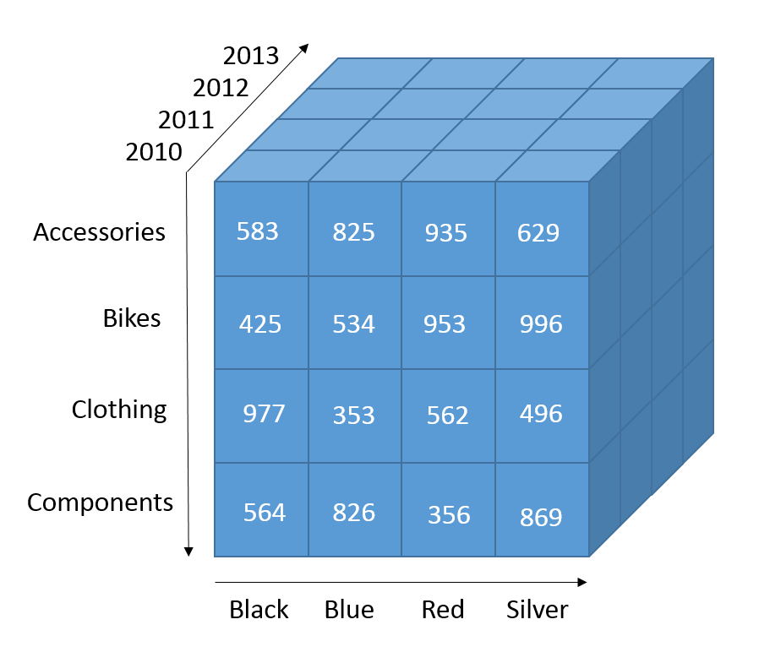
Data Cube
A Data Cube is a multidimensional data structure used by OLAP to organize information for faster analysis. The main components are:
Dimensions
These describe how data is categorized.
Examples
Time
Product
Region
Customer
Measures
These are numerical values being analyzed.
Examples
Sales
Profit
Revenue

Slide 8
Relationship b/w OLAP & Data Cube
OLAP | Data Cube
Technology | Data Structure
Performs analysis | Stores multidimensional data
Used by analysts | Created by OLAP Server
Executes operations | Provides data for operations
Supports BI | Organizes information

Slide 9
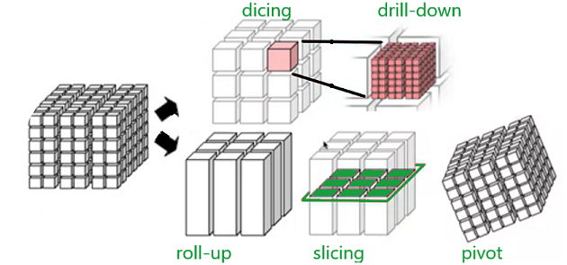
OLAP Operations
OLAP Operations
Slice
Dice
Roll-up
Drill-down

Slide 10
Slice
Selects one value of a single dimension.
Example:
To check the January data for sales
Time = January
Entire Cube
↓
Only January Data

Slide 11
Dice
Selects multiple values across dimensions and returns only the selected subset.
Example:
Product = Laptop
Region = South
Time = January–March

Slide 12
Roll-up
Moves from detailed data to summarized data.
Daily
↓
Monthly
↓
Quarterly
↓
Yearly
Example:
Monthly Sales → Annual Sales

Slide 13
Drill-down
Moves from summarized data to detailed data.
Yearly
↓
Quarterly
↓
Monthly
↓
Daily
Example:
Annual Sales → Monthly Sales

Slide 14
Limitations of OLAP
High implementation cost
Requires large storage for data cubes
Cube creation can be time-consuming
Complex to maintain with frequent data updates
Not suitable for real-time transaction processing

Slide 15
Conclusion
OLAP is a powerful analytical technology used in Business Intelligence.
Data Cubes organize data into multidimensional structures for efficient analysis.
OLAP operations (Slice, Dice, Roll-up, Drill-down) are performed on Data Cubes to explore and analyze information.
Together, OLAP and Data Cubes enable organizations to transform raw data into meaningful insights, improving decision-making and strategic planning.

